Slide 1
A minimal OS for the Raspberry Pi, suitable for educational purposes
Team Code Conqueror

Slide 2
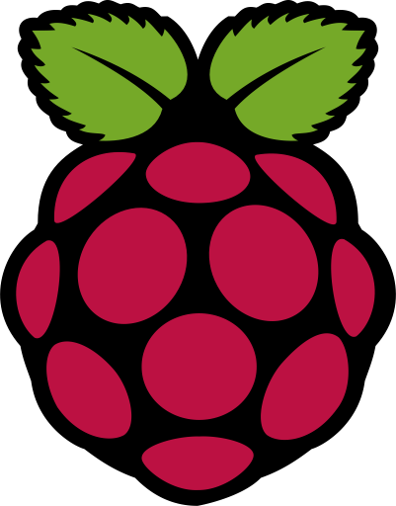
What is Raspberry Pi?
•The Raspberry Pi is a series of compact single-board computers created by the Raspberry Pi Foundation in the United Kingdom to support the teaching of basic computer science in schools and underdeveloped nations.
• The initial model was significantly more successful than expected, selling outside of its intended market for applications such as robotics.
• Before February 2015, almost 5 million Raspberry Pis had been sold, making it the best-selling British computer. They have sold 11 million devices by November 2016.

Slide 3
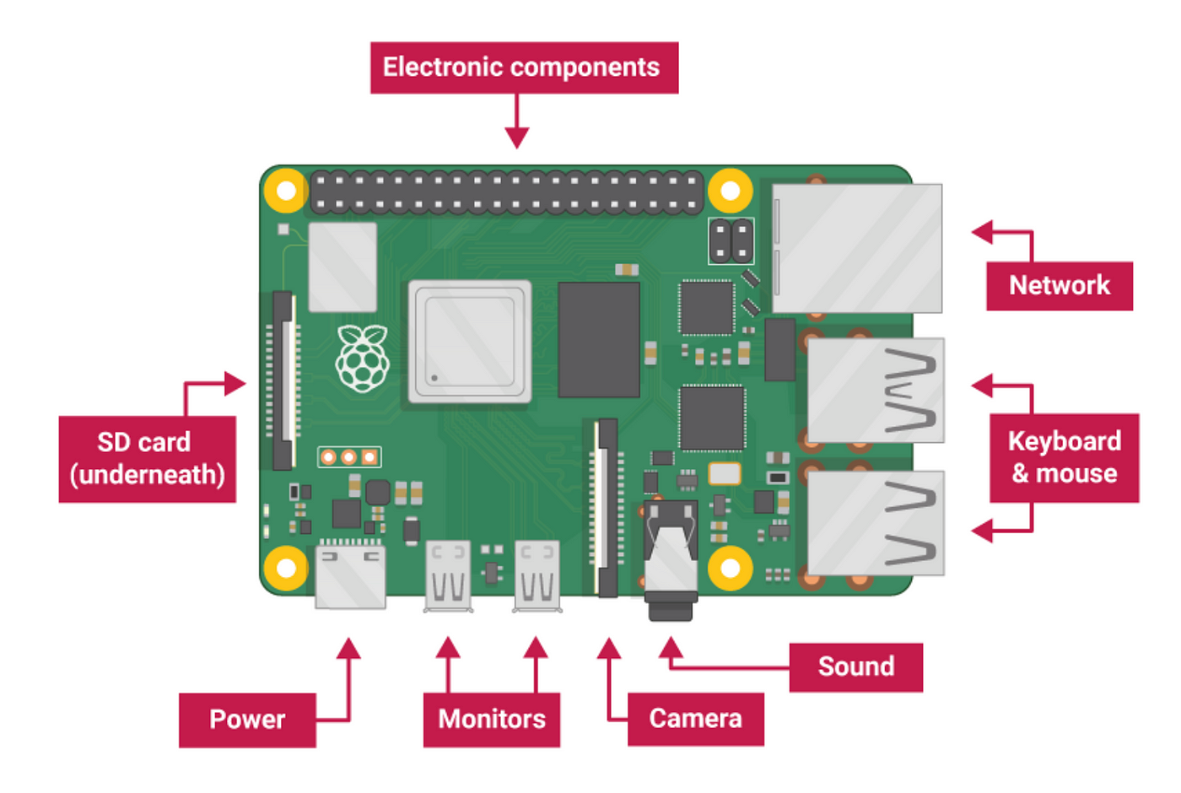
Raspberry Pi board

Slide 4
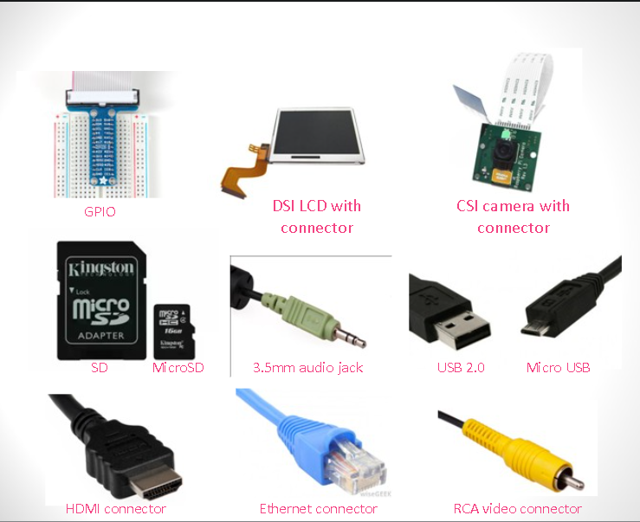
Components

Slide 5
Components
Essential:
→Raspberry Pi board
→Prepared Operating System SD Card
→USB keyboard
→Display (with HDMI, DVI, or Composite input)
→Power Supply
Highly suggested extras include:
→USB mouse
→Internet connectivity - LAN cable
→Powered USB Hub
→Case

Slide 6
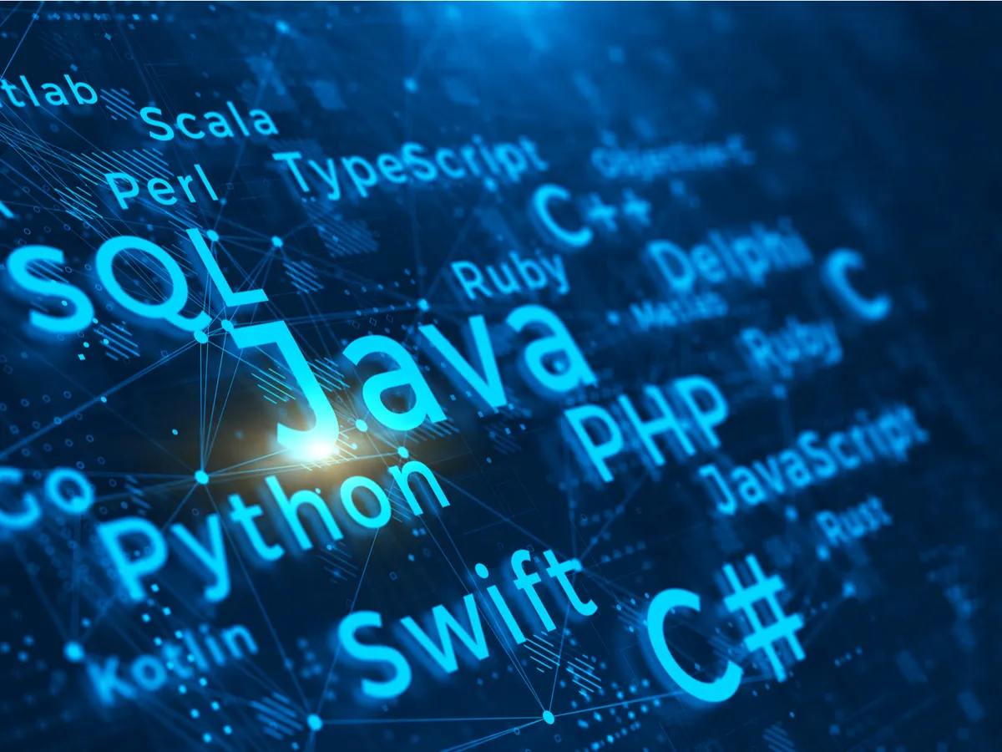
Programming language
The Raspberry Pi Foundation recommends Python
Any language which will compile for ARMv6 can be used
Installed by default on the Raspberry Pi:
→C
→C++
→Java
→Scratch
→Ruby

Slide 7
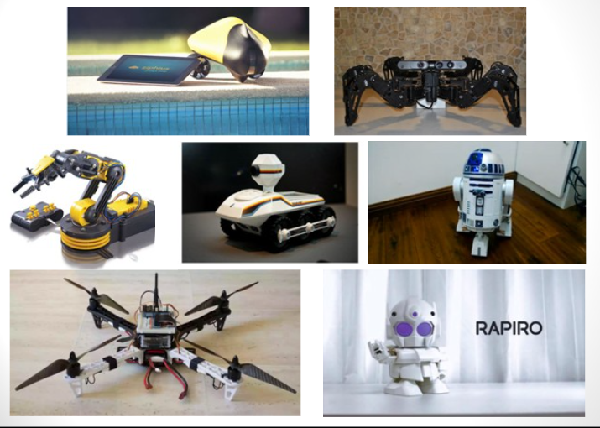
Robots and drones
Drones: A Raspberry Pi can give a drone significant computing power on board, allowing access to technologies such as AI. For example, a camera-equipped Raspberry Pi can use computer vision to determine where a drone is when flying indoors.
Robotics:A Raspberry Pi can be used for a wide range of robotics applications, including desktop robots, mobile robots, industrial robots, and more. For example, a Raspberry Pi can be used to construct a six-axis collaborative robot arm.

Slide 8
Timeline Of Raspberry Pi ->
In February 2012, the first generation (Raspberry Pi 1 Model B) was released. Model A, a simpler and less expensive model, followed.
In 2014, the Raspberry Pi Foundation released a board with an updated design called the Raspberry Pi 1 Model B+. These boards are roughly the size of a credit card and represent the basic mainline form-factor.
A year later, improved A+ and B+ models were released. In April 2014, a "compute module" for embedded applications was published, while in November 2015, a Raspberry Pi Zero with lower size and decreased input/output (I/O) and general-purpose input/output (GPIO) capabilities was released for US$5.

Slide 9
In February 2015, the Raspberry Pi 2 with additional RAM was released.
The Raspberry Pi 3 Model B, which was released in February 2016, includes on-board WiFi, Bluetooth, and USB boot capabilities.
As of January 2017, the newest mainline Raspberry Pi is the Raspberry Pi 3 Model B.
Raspberry Pi boards range in price from $5 to $35 USD.
On February 28, 2017, the Raspberry Pi Zero W, which is identical to the Raspberry Pi Zero but features the Wi-Fi and Bluetooth functionality of the Raspberry Pi 3, was released for US$10.

Slide 10
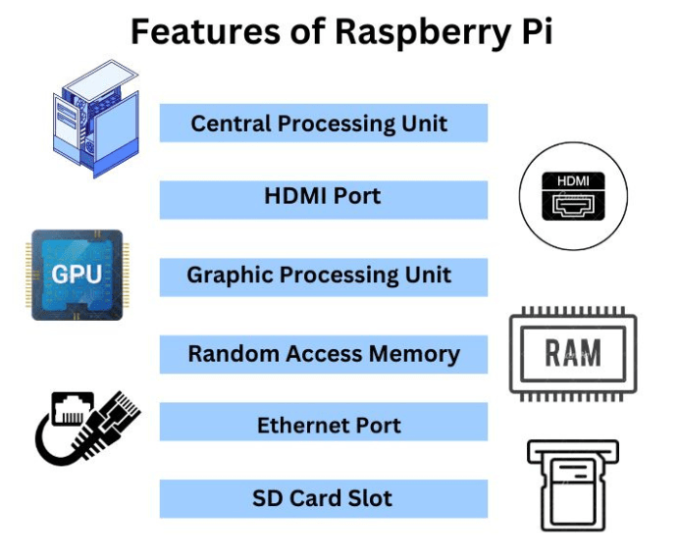
Features

Slide 11
Features
All models use a Broadcom system on a chip (SoC), which features an ARM-compatible CPU and an on-board graphics processing unit (GPU, a VideoCore IV).
The Pi 3's CPU speed goes from 700 MHz to 1.2 GHz, and on-board memory spans from 256 MB to 1 GB RAM.
Secure Digital (SD) cards in SDHC or MicroSDHC sizes are utilised to store the operating system and programme memory.
Most boards offer one to four USB ports, HDMI and composite video output, and an audio 3.5 mm phono connector.
A number of GPIO pins provide lower level output and support standard protocols such as I2C.
The B-models include an 8P8C Ethernet port, whereas the Pi 3 and Pi Zero W include built-in Wi-Fi 802.11n and Bluetooth.

Slide 12
Key component
CPU: The Raspberry Pi has a single-core ARMv6 700 MHz processor. The Raspberry Pi 4 has a quad-core Cortex-A72 64-bit CPU running at 1.5GHz.
GPU:The Raspberry Pi has a VideoCore IV GPU. The Raspberry Pi 4 has a Broadcom VideoCore VI GPU running at 0.5GHz.
RAM:The Raspberry Pi 1 has 512MB of RAM. The Raspberry Pi 4 has 40 GPIO pins.
Storage:The Raspberry Pi uses an SD card for its operating system and data storage. The Raspberry Pi 400 has 4GB of RAM.
GPIO pins:The Raspberry Pi has a row of GPIO (general-purpose input/output) pins along the top edge of the board. The Raspberry Pi 1 Models A and B have only the first 26 pins.

Slide 13
Variations of Raspberry Pi
Hardware platform:
Software platform:
Raspberry Pi Zero ($5) :Cost-effective, basic model
Standard Raspberry Pi:Standard model for general-purpose computing
Raspberry Pi 2:Improved performance and features
Raspberry Pi 3 (with Wifi + Bluetooth):Enhanced connectivity opt
Noobs: Beginner-friendly operating system installer
Raspbian:Official operating system based on Debian, optimized for Raspberry Pi
3rd OS :Customizable, depending on project needs

Slide 14
History
The Foundation's intention was to sell two versions, each priced at $25 and $35 USD.
They began accepting orders for the more expensive Model B on February 29, 2012, and the less expensive Model A on February 4, 2013. and the even more affordable (US$20) A+ on November 10, 2014.
On November 26, 2015, the Raspberry Pi Zero, the cheapest Raspberry Pi yet, was released for $5 .

Slide 15
Why to use raspberry Pi
The Raspberry Pi is a good choice for people new to computing and programming because it's simple, cheap, and runs on Linux.
The Raspberry Pi 4 Model B costs $35.
The 2GB Raspberry Pi 4 costs $45.
The 8GB Raspberry Pi 4B costs $75.
The Raspberry Pi 3 – Model A+ costs $25
The cheapest Raspberry Pi is the Raspberry Pi Zero, which costs $5.

Slide 16
Raspberry Pi - Operating System:
A Raspberry Pi operating system (OS) is a specialized software designed to run on Raspberry Pi, a small, affordable, single-board computer. The Raspberry Pi OS is responsible for managing the computer's hardware resources and providing a user interface for interaction.
Here are the core functions of a Raspberry Pi operating system:
Process Management:
This involves managing the execution of programs or processes. The OS is responsible for starting, pausing, terminating, and scheduling processes to make the most efficient use of the CPU.
Memory Management:
The OS allocates and deallocates memory for processes. It ensures that each program gets the required memory space and protects them from interfering with each other.

Slide 17
Device Management:
This involves managing input and output devices such as USB peripherals, displays, keyboards, and networking interfaces. The OS facilitates communication between software and hardware components.
User Interface (UI):
The UI provides a way for users to interact with the Raspberry Pi. It can be a command-line interface (CLI) where users type commands, or a graphical user interface (GUI) with windows, icons, buttons, and menus.
Networking:
The OS handles network connections, allowing the Raspberry Pi to communicate with other devices over a network, be it wired or wireless.
This includes configuring IP addresses, managing protocols (like TCP/IP), and handling network services.
Security:
The OS implements security measures to protect the system from unauthorized access, viruses, and other threats. This can include user authentication, encryption, and firewall settings.

Slide 18
File System:
The file system manages how data is stored, organized, and accessed on the storage media (like SD cards or USB drives). It provides a hierarchical structure for files and directories.
Driver Management:
Drivers are software components that allow the OS to communicate with specific hardware devices. The OS loads and manages these drivers to ensure proper functioning of attached peripherals.
Updates and Maintenance :
The OS may include mechanisms for updating itself and installed software packages to patch security vulnerabilities or add new features.
File System Permissions:
The OS enforces access controls on files and directories, ensuring that only authorized users or processes can read, write, or execute them.

Slide 19
Error Handling:
The OS is responsible for detecting and managing errors that may occur during operation. This can include hardware errors, software crashes, or other unexpected events.

Slide 20
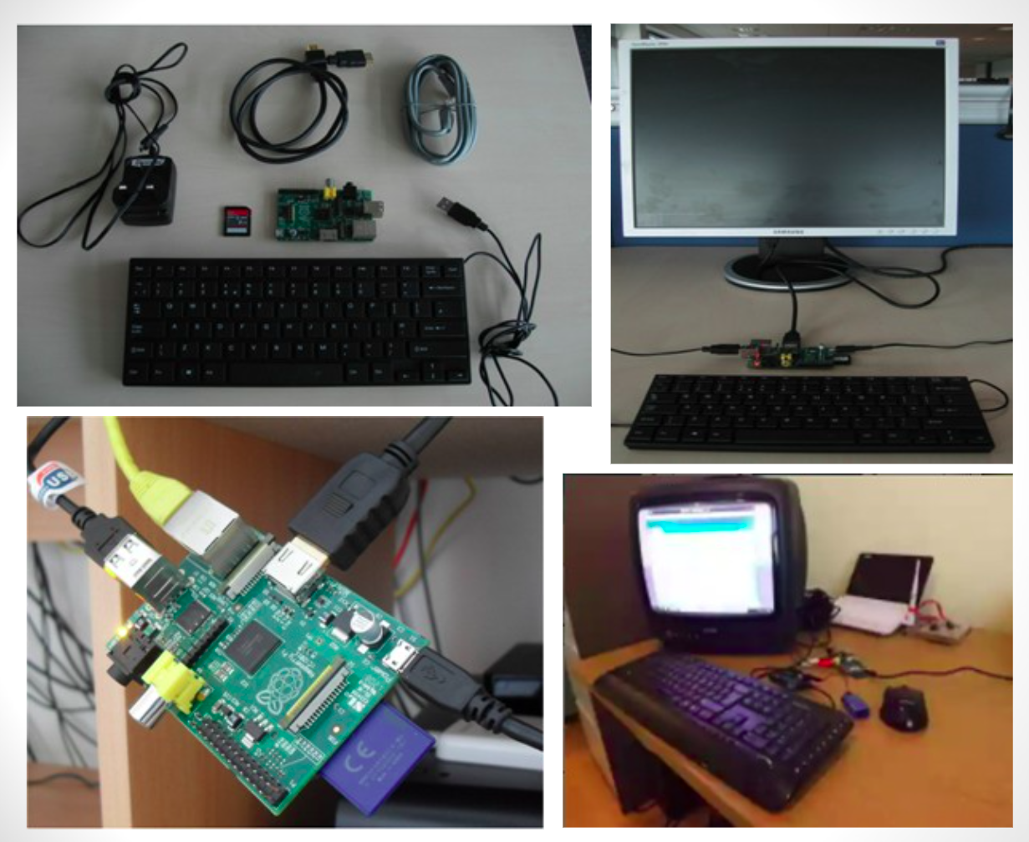
Summary
The Raspberry Pi is a low-cost, multifunctional single-board computer used in education and home improvement projects. It is compatible with Linux-based operating systems and includes GPIO pins for hardware interface. It's a popular choice for learning, prototyping, and creative endeavours.

Slide 21
PROS
Cons
Limited performance.
Limited storage options.
Noisy audio output.
Limited graphics capabilities.
Compatibility issues.
No built-in battery backup.
Learning curve for beginners.
Limited networking options on some models
Affordable
Versatile for a wide range of projects
Strong community and support
Low power consumption
Compact size
Rich GPIO support
Customizable
Open-source
Great for education.

Slide 22
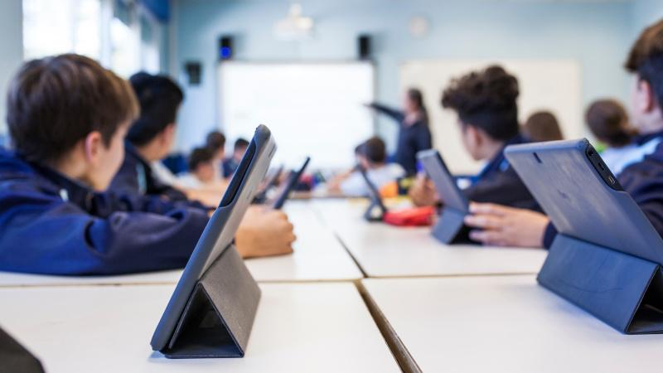
To make Raspberry Pi more suitable for educational purposes

Slide 23
Raspberry Pi: A Game-Changer for Education
This compact device offers students hands-on experience in programming, electronics, and robotics, making it an invaluable resource for schools and educational institutions.

Slide 24
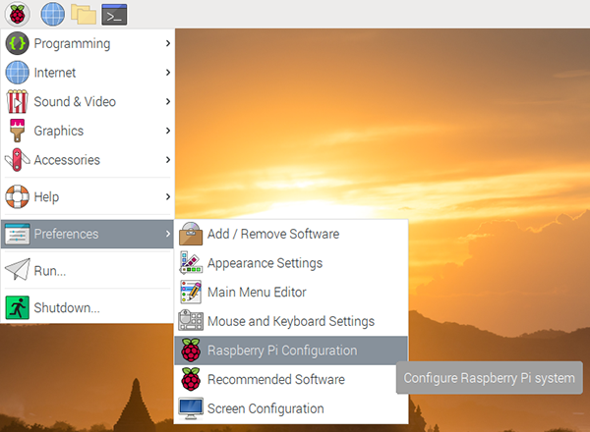
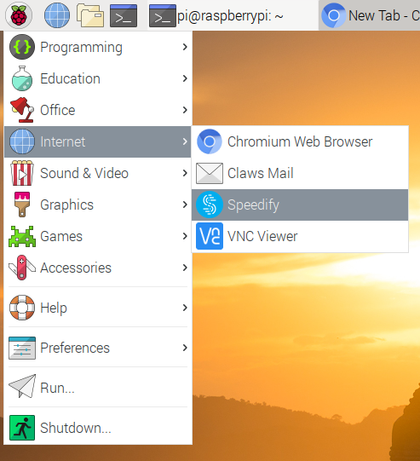

Slide 25
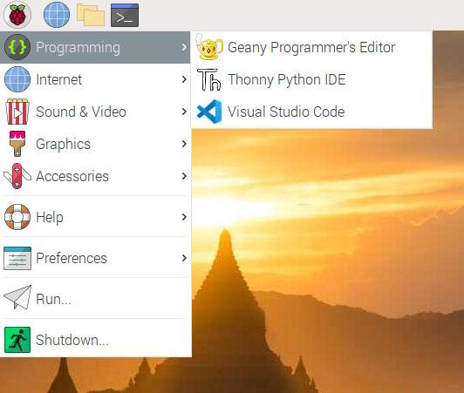

Slide 26
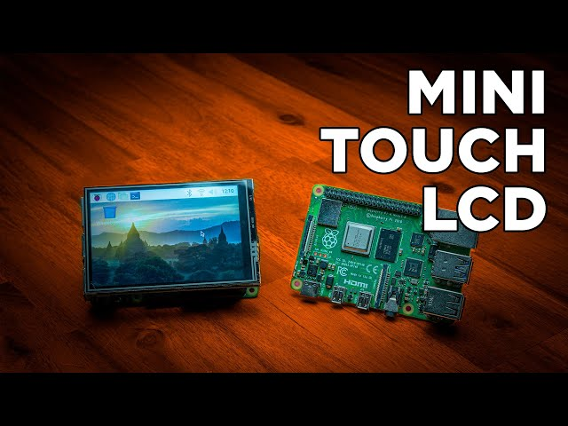
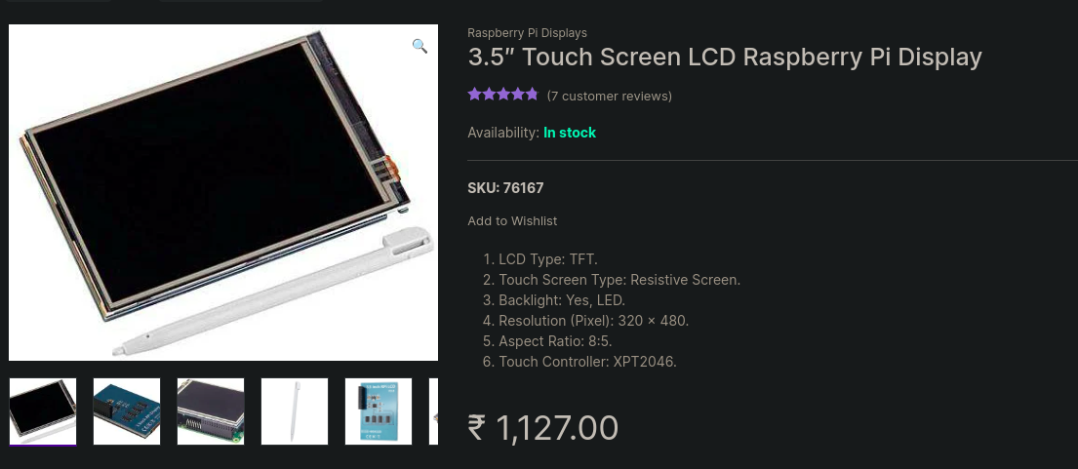

Slide 27
How We Boot this Raspberry pi
Insert a bootable USB/sd card that has the Raspberry Pi OS.
Connect any necessary accessories (keyboard, mouse, monitor, and power).
Switch on the Raspberry Pi.It initialises and loads the operating system from the USB Drive.
You can access it by logging in.
It can also boot into a custom application or script for your project.

Slide 28
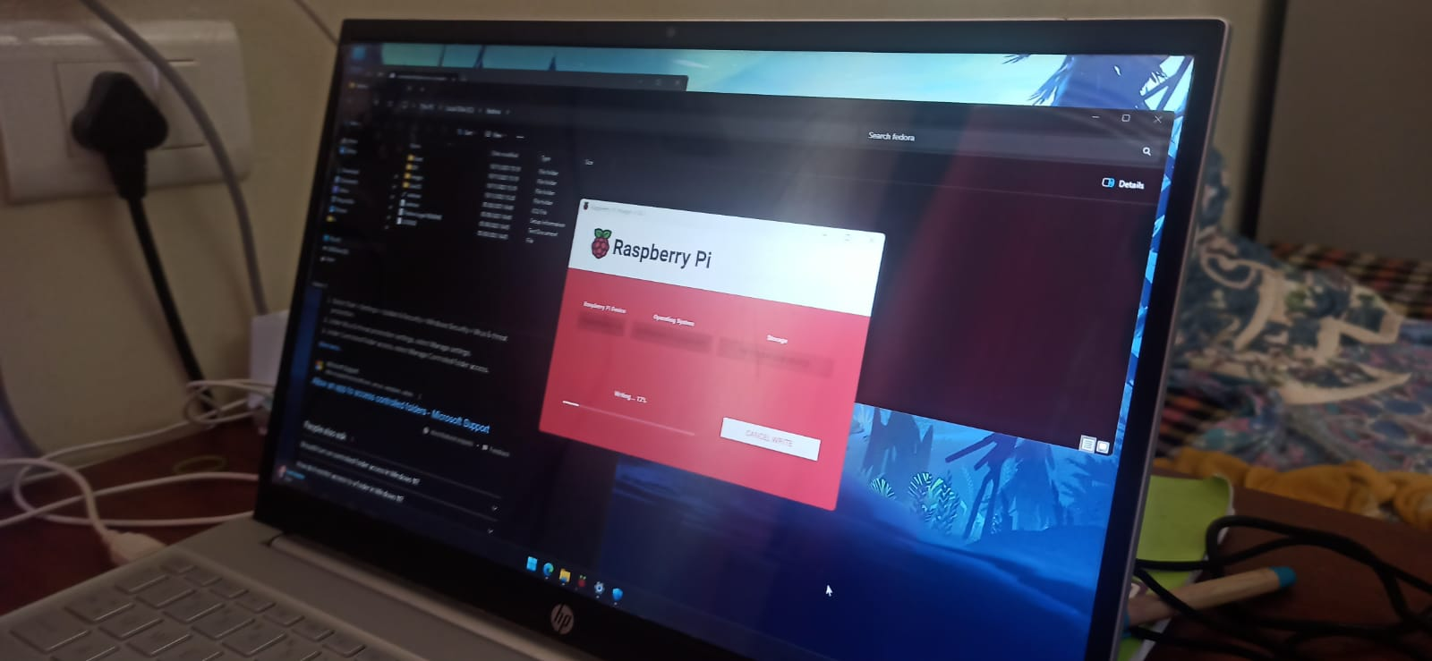

Slide 29
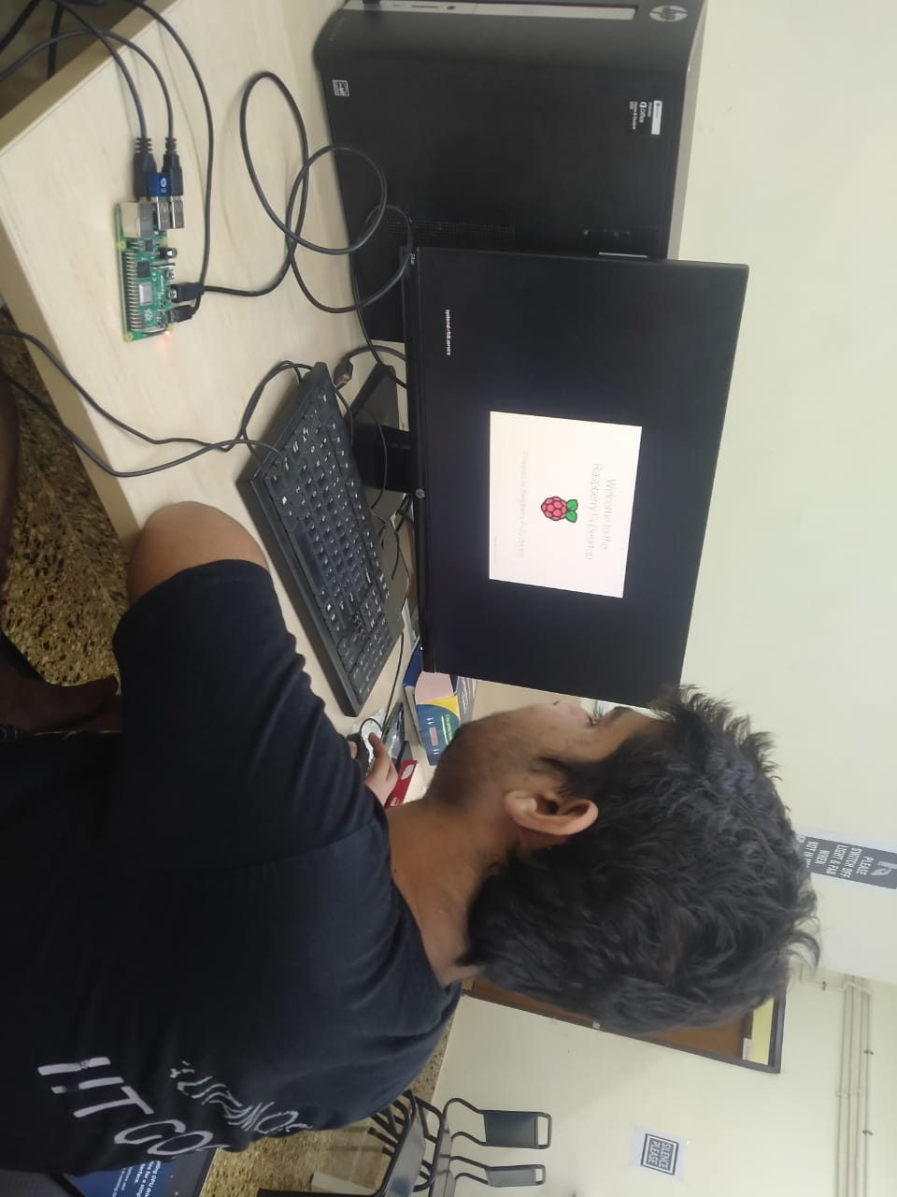
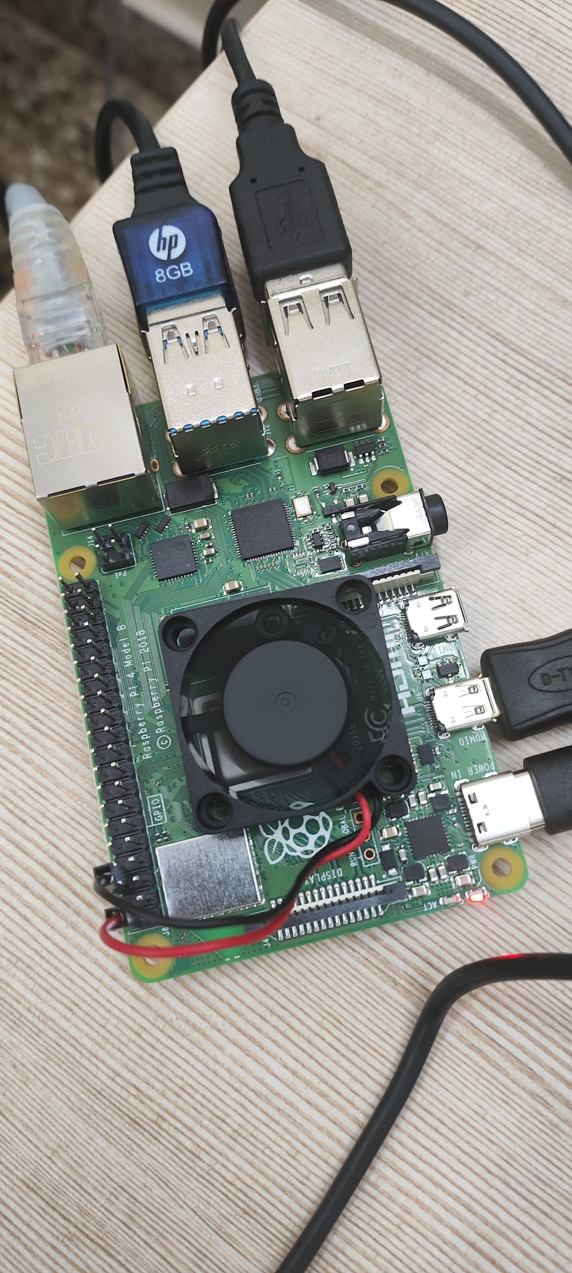
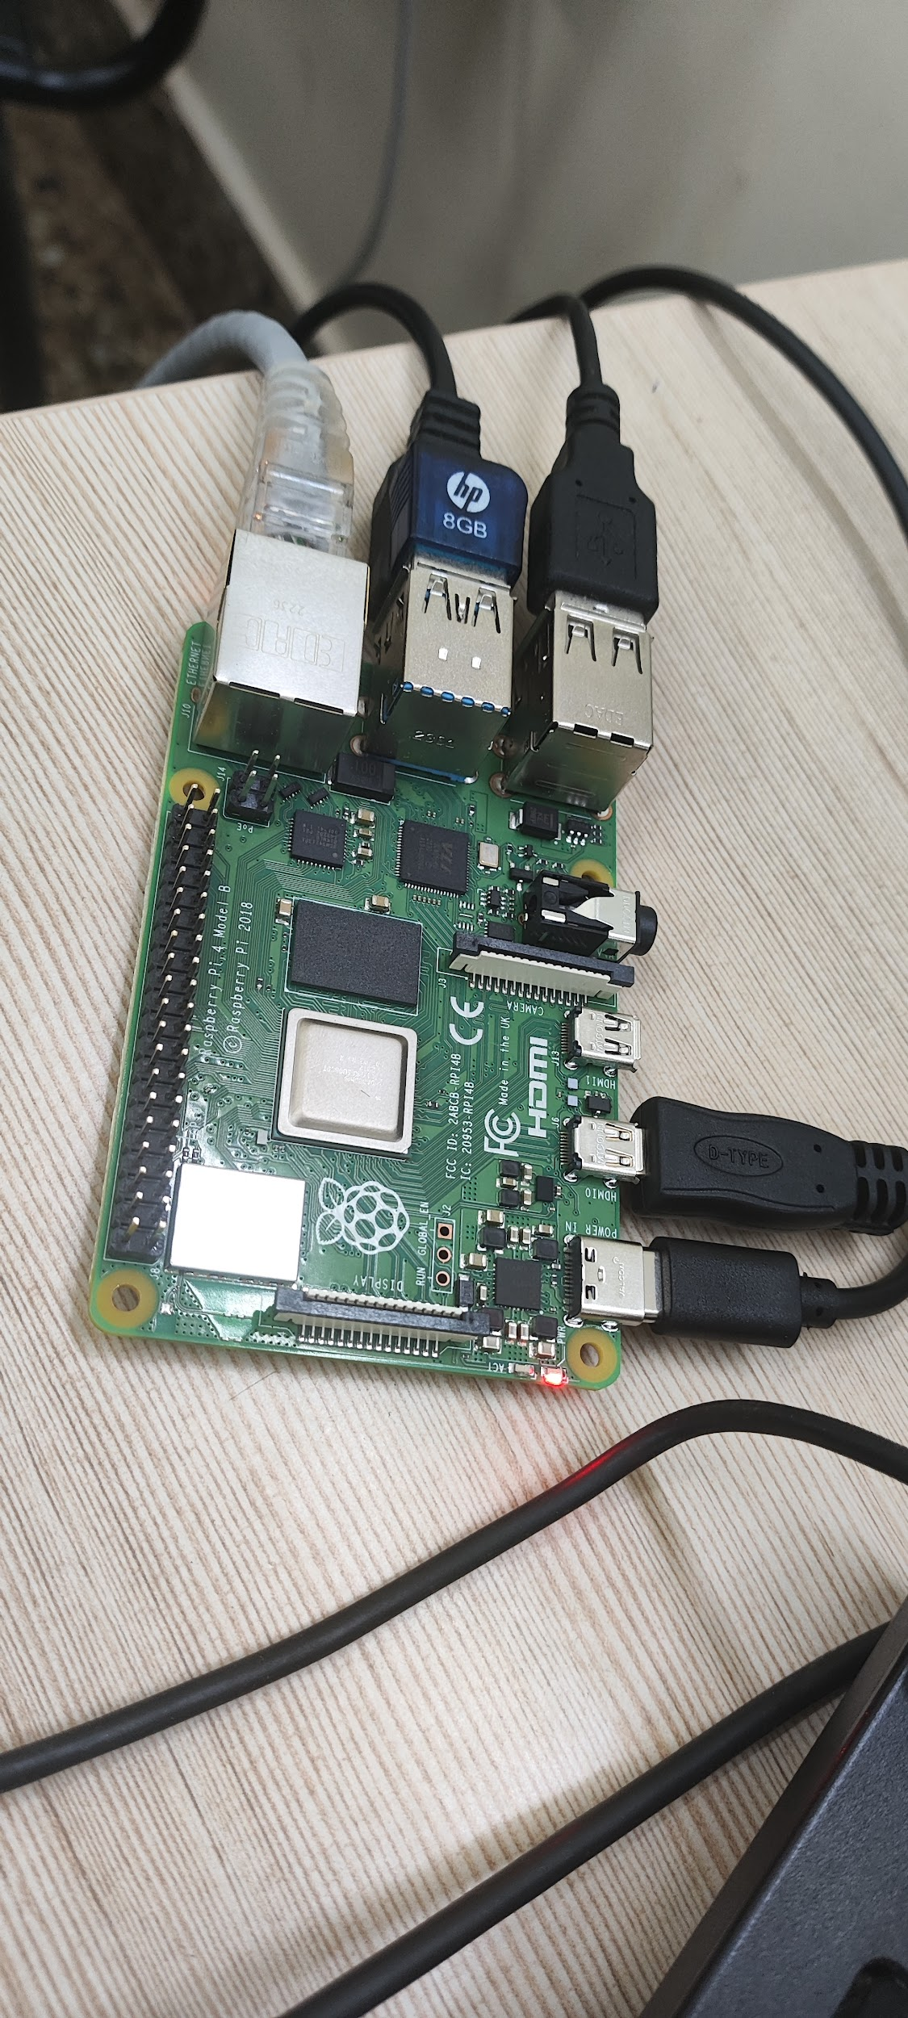
Set up of raspberry pi

Slide 30
Bootloader to load your kernel.
Between the two USB drives, one exhibits superior read and write operations, resulting in faster boot times compared to the other.Link: https://drive.google.com/file/d/1IQwFM1Q5INQUkR4yqIEBrxs7tAKA6IHT/view?usp=sharing
TESTED WITH TWO USB DRIVES
We see difference in opening and rebooting time with raspberry pi
So this is a major factor try to use a Good read and write speed, SD card / USB Drive

Slide 31
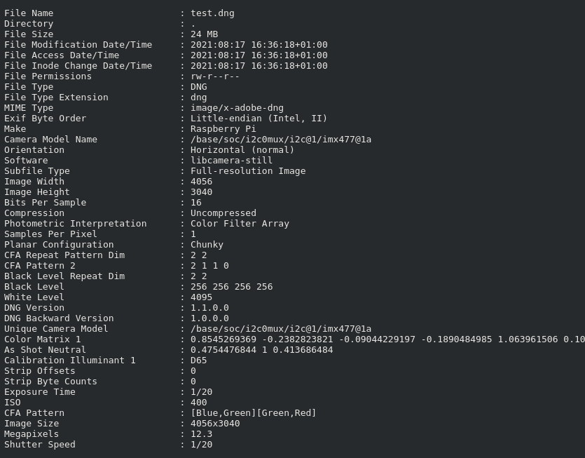
Raspberry Pi Cameras
libcamera and libcamera-apps
libcamera and libcamera-apps
So the point is, students need webcam for classes and all

Slide 32
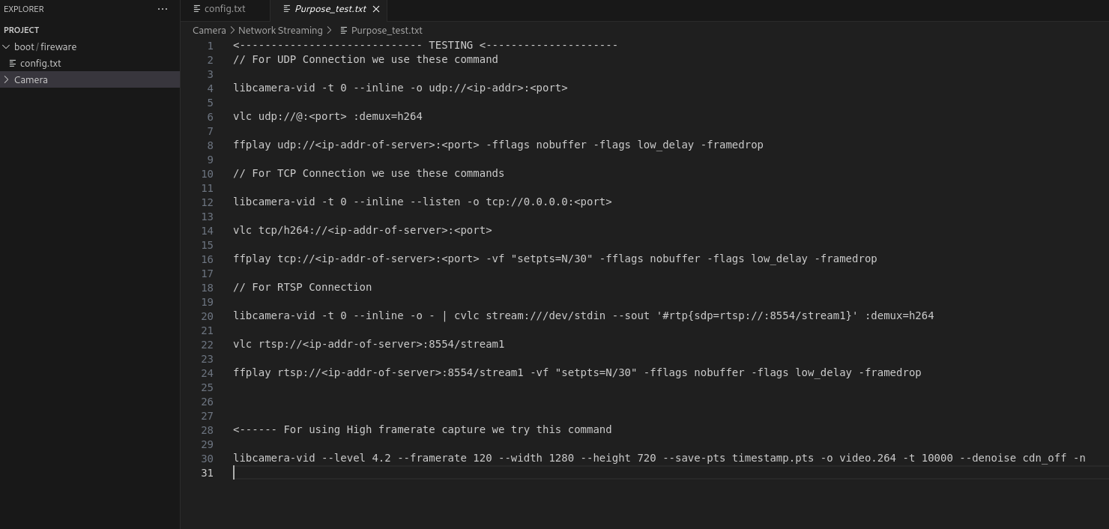
Raspberry Pi Camera
libcamera and libcamera-apps
So the point is, students need webcam for classes and all
Understand and change in Network Streaming
<------Like For using High frame rate capture we try this command —->
libcamera-vid --level 4.2 --framerate 120 --width 1280 --height 720 --save-pts timestamp.pts -o video.264 -t 10000 --denoise cdn_off -n

Slide 33
Raspberry Pi Camera
--sharpness Set image sharpness <number>
--shutter Set the exposure time in microseconds <number>
--ev Set EV compensation <number>
--saturation Set image colour saturation <number>
--contrast Set image contrast <number>
--brightness Set image brightness <number>
By Importing these things in our camera module file we can direct use these commands for changing in camera setting for our educational purpose

Slide 34
Raspberry Pi Reduce File Sizes
We don't have much space on the Raspberry Pi, which is why we modified the code to reduce the size of all image formats, such as JPG, PNG, etc."

Slide 35
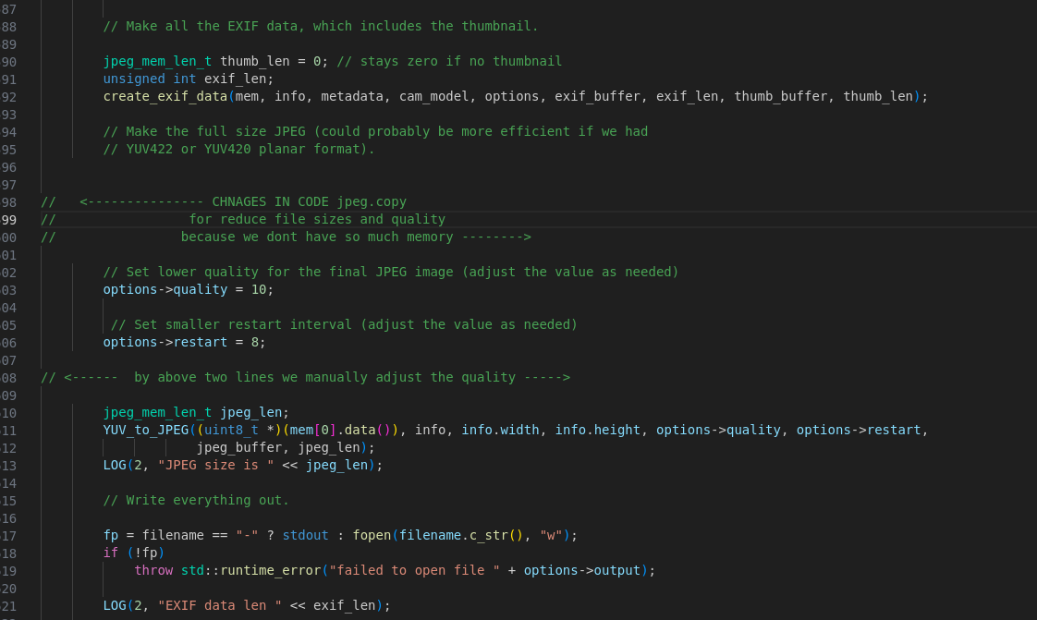
Raspberry Pi Camera
By Importing these things in our camera module file we can direct use these commands for changing in camera setting for our educational purpose
jpeg.cpp

Slide 36
How above code works ?
Lowering Quality for Higher Compression
options->quality = 10; // Lower quality for higher compression
Smaller Restart Interval for Improved Compression:
options->restart = 8; // Smaller restart interval may improve compression

Slide 37
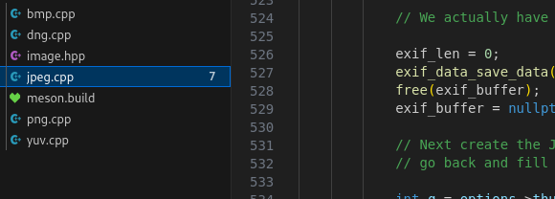
Same changes we can do in other files formats

Slide 38
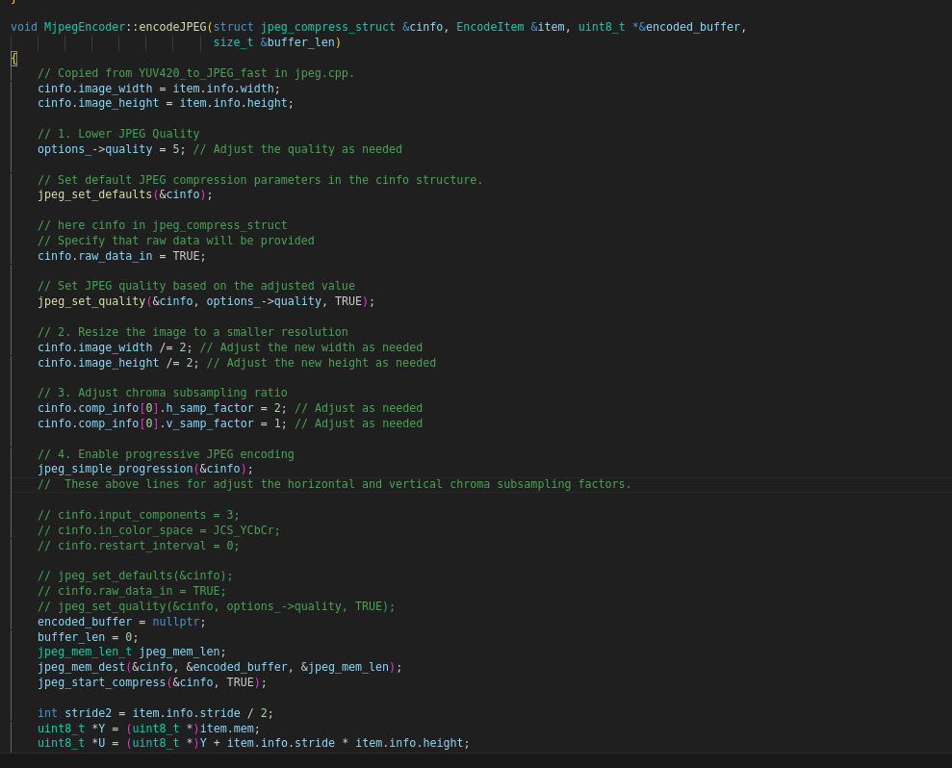
Next we optimize the encoder to work as a powerful enoder and reduce our file size more
mjpeg_encoder.cpp

Slide 39
How above code works ?
Above Four Changes works for these =>
Lower JPEG Quality
Resize the Image to a Smaller Resolution
Adjust Chroma Subsampling Ratio
Enable Progressive JPEG Encoding

Slide 40
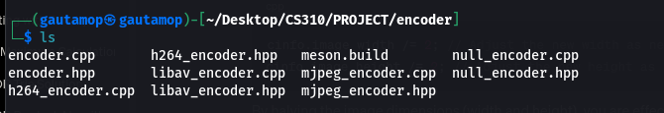
Same changes we can do in other files formats

Slide 41
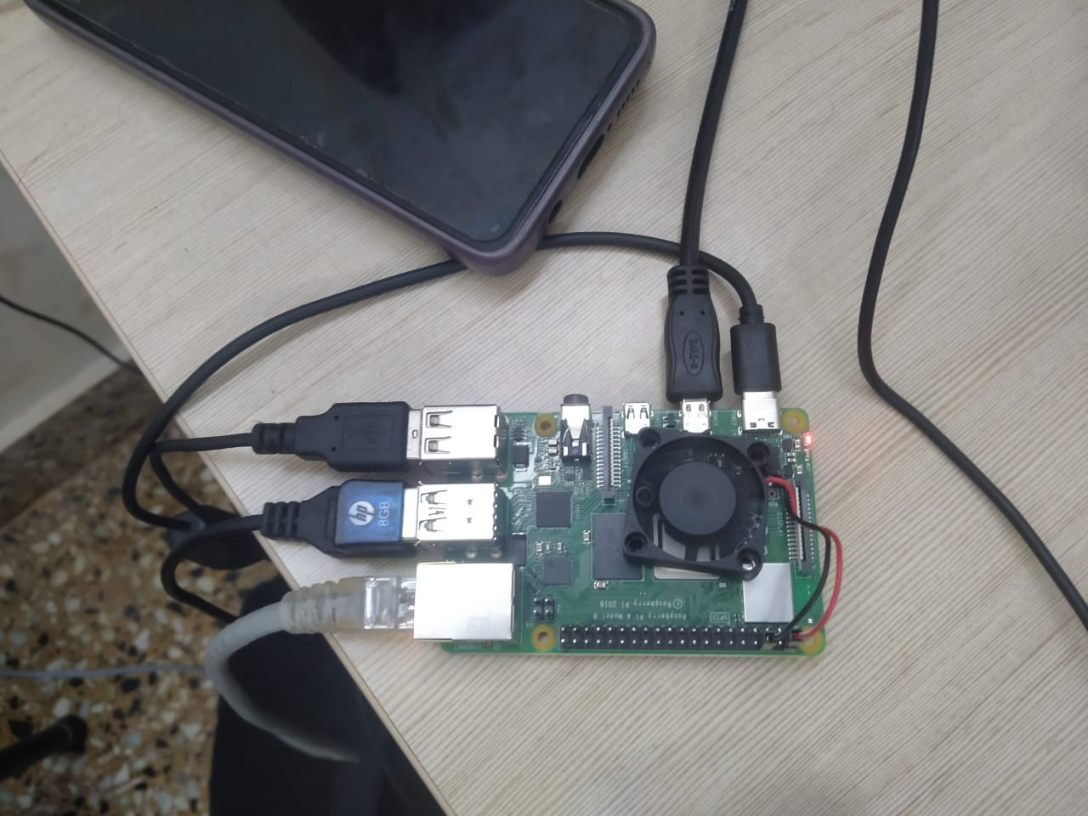
Things we observed
After using the raspberry pi for a while the cpu becomes very warm.
For this we need to stop the processes which we don’t need .

Slide 42
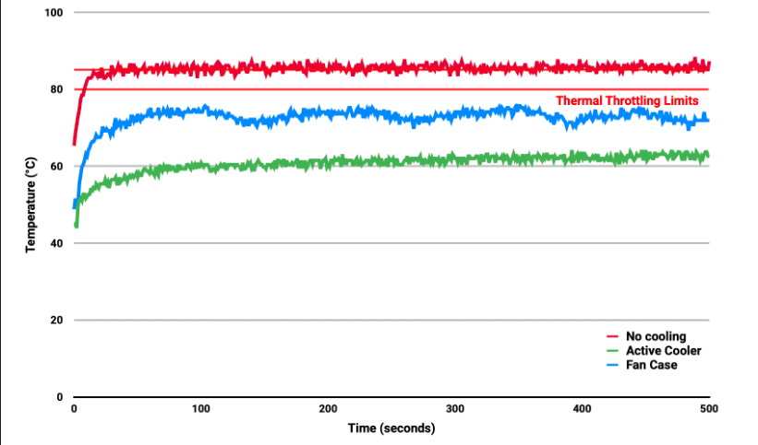

Slide 43
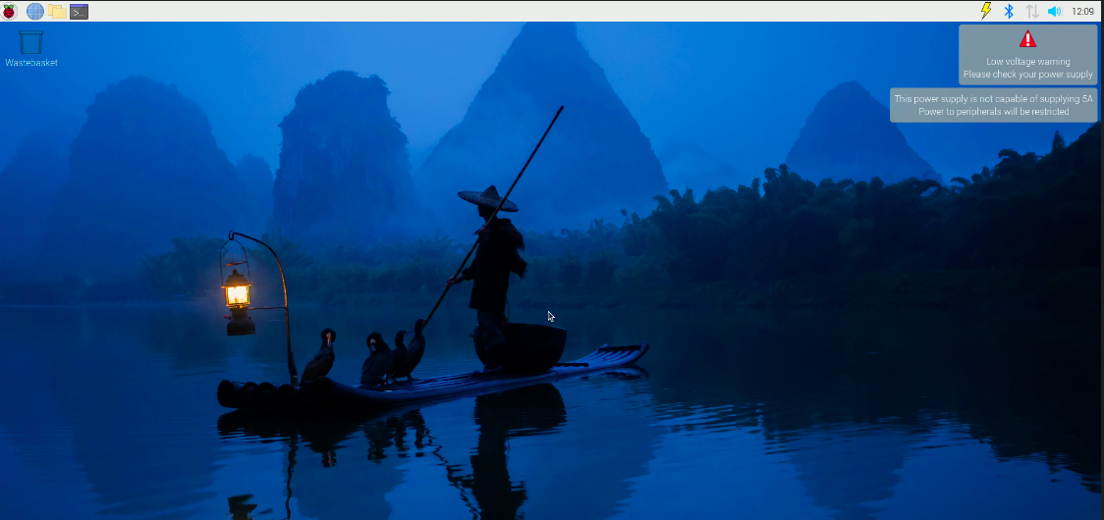
Things we observed
Used fan to avoid the head up
vcgencmd pmic_read_adc

Slide 44
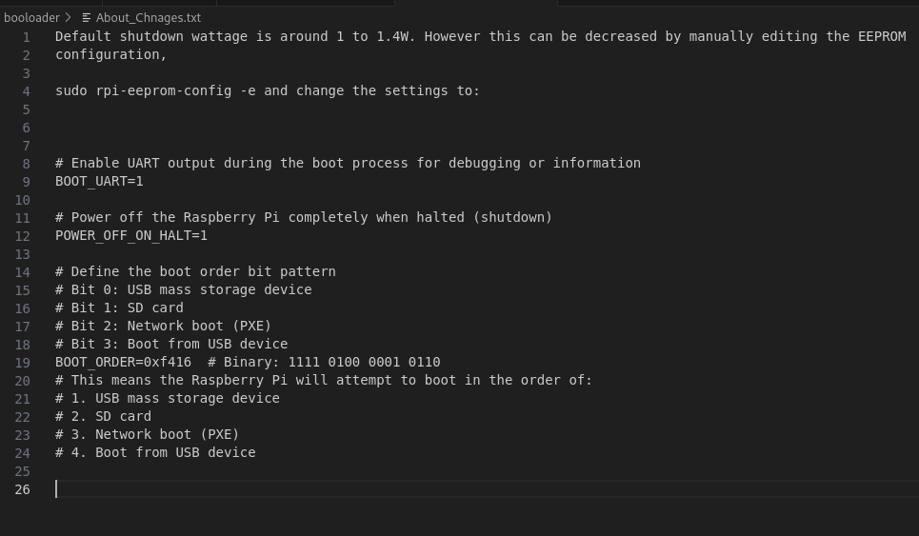
Bootloader - Shutdown Time
Used fan to avoid the head up

Slide 45
Bootloader - Shutdown Time
– enable Universal Asynchronous Receiver-Transmitter.
BOOT_UART=1
– Power Off the Raspberry Pi when halted (shutdown)
POWER_OFF_ON_HALT=1
– RP will attempt to boot in order
BOOT_ORDER=0xf416

Slide 46
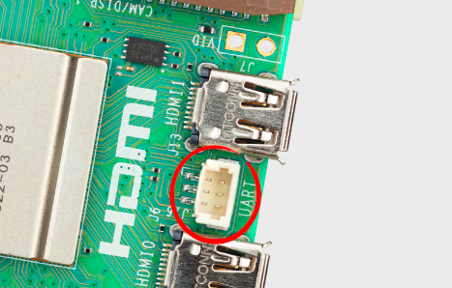
Bootloader - Shutdown Time
UART is a standard communication protocol used for transmitting and receiving serial data.
– enable Universal Asynchronous Receiver-Transmitter.
BOOT_UART=1
– Power Off the Raspberry Pi when halted (shutdown)
POWER_OFF_ON_HALT=1
– RP will attempt to boot in order
BOOT_ORDER=0xf416

Slide 47
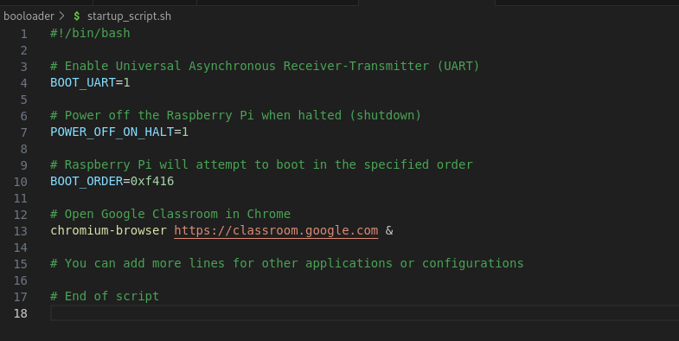
Now we want to open some applications automatically when we start our Raspberry Pi

Slide 48
I am a student, and I don't want to open the classroom every time manually. So, I have attached my bash script with a bootloader. Now, when I open my Raspberry Pi, the script runs automatically and opens the classroom directly.

Slide 49
We can modify this according to our requirements. Additionally, we can add scripts for YouTube educational playlists, emails, etc

Slide 50
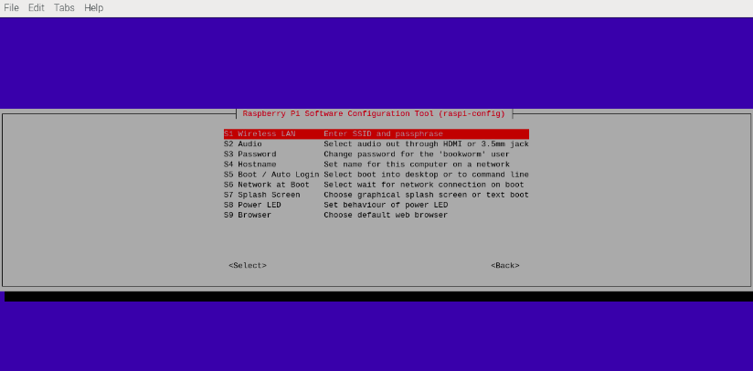
Raspberry Pi Settings

Slide 51
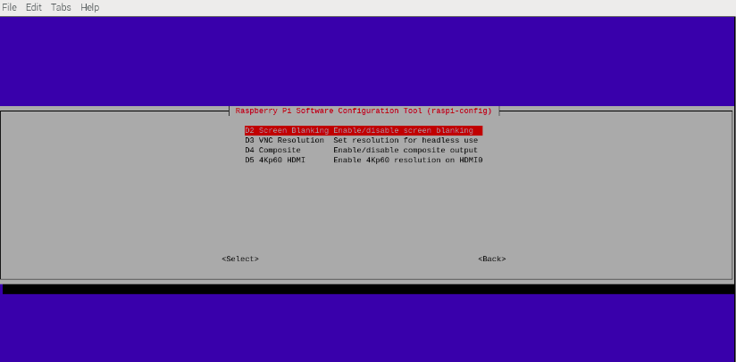
Raspberry Pi Settings

Slide 52
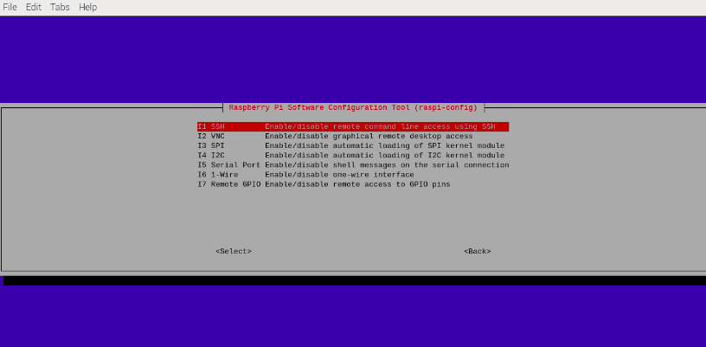
Raspberry Pi Settings

Slide 53
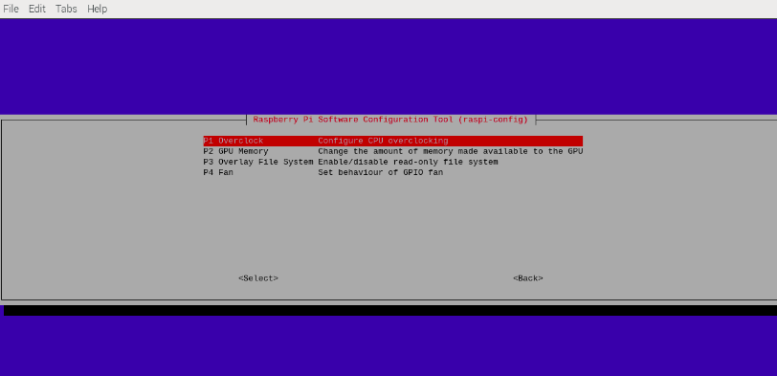
Raspberry Pi Settings

Slide 54
Raspberry Pi Settings
Raspberry Pi Settings We can modify these settings according to our requirements. There are many useful configurations that are beneficial for students.

Slide 55
More Modifications and customizations for
Educational Purpose
Modifying the bootloader to load your kernel.
Customizing device drivers for hardware access. (We can do this if we get permission)
Adapting GPU drivers or libraries for a simplified user interface.
Tweaking system configuration to reduce resource usage.
Implementing hardware-specific code for the Raspberry Pi's unique features.

Slide 56
Important Topic which can be Modified
Tweaking System Configuration
Tweaking the system configuration involves optimizing your OS for resource usage.
We reduce resource usage by disabling unnecessary services, optimizing memory usage, and using minimal configurations.
by using configuration files for the kernel and system services to make these adjustments

Slide 57
Important Topic which can be Modified
Adapting GPU drivers or libraries for a simplified user interface.
Do customizations and Modifications in existing GPU libraries

Slide 58
Important Topic which can be Modified
Implementing Hardware-Specific Code:
-> Writing code specific to the Raspberry Pi's unique features or hardware components (e.g., VideoCore, camera module, or HATs).
-> Study official Raspberry Pi documentation and then Create hardware-specific code to enable and control these features in your OS.

Slide 59


Team Members
Gautam Kumar Mahar
Kanwar Raj
Akansha Madavi
Afzal Hussain
Thaksen Karote

Slide 60
